Slide 1
Assignment
24 August 2011
Notes:
Assignment - <number>
Guidewire training materials contain Guidewire’s confidential information subject to confidentiality and non-disclosure agreements. You agree to use the information in this manual solely for the purpose of training to implement Guidewire’s software solutions. You also agree not to disclose the information in this manual to third parties or copy this manual without Guidewire’s prior written consent. Guidewire training may only be given by Guidewire employees or certified Guidewire partners under the appropriate agreement with Guidewire.

Slide 2
Lesson objectives
By the end of this lesson, you should be able to:
  Identify the assignable objects
  Describe how assignment can be done at the group level
  Describe how assignment can be done at the user level (where the final owner is chosen by rules)
  Describe how assignment can be done at the user level (where the final owner is chosen by a user)
  This lesson uses the notes section for additional explanation and information.
  To view the notes in PowerPoint, choose View→Normal or View→Notes Page.
  If you choose to print the notes for the lesson, be sure to select “Print hidden slides.”
Notes:
Assignment - <number>

Slide 3
Lesson outline
Assignment basics
Group assignment
User assignment via rules
User assignment via users
Notes:
Assignment - <number>

Slide 4

Assignable objects
An assignable object is an object that has work associated to it which must be completed by a user
Four types of assignable objects in the base application:
Claim
Exposure
Activity
Matter
Notes:
Assignment - <number>
Assignment is the act of selecting an owner for an assignable object.
A matter is a set of data pertaining to a single (potential) lawsuit. Matters are discussed in the "Specialized claims Processes" lesson.
User-defined entities can be configured to be assignable as well.

Slide 5
The outcome of assignment
Upon completion, assignable objects are assigned to a group and a user in that group
Notes:
Assignment - <number>
For claims and activities, it is possible to assign the object to a temporary location before the final user and group have been selected. (Claims can temporarily be assigned to a "Pending assignments" list, and activities can be assigned to a group queue.) However, these locations are only intermediate points in the assignment process. Eventually, every assignable object is assigned to a group and a user in that group.

Slide 6

When and how does assignment occur?
 | How is new owner chosen?
 | Rule-Based Assignment | Explicit Assignment
Creation of new object
Reassign- ment of Existing object
He gets it.
When is object assigned?
He gets it.
owner 1
owner
2
owner
1
owner
2
Notes:
Assignment - <number>
Assignment occurs:
When an assignable object is created
When the owner (or someone with sufficient permissions) explicitly chooses to reassign an object
In either case, the owner can be:
Specified explicitly
Chosen through assignment rules
In the base application, the owner of an object and the supervisors he or she reports to (directly or indirectly) can reassign an object. In some cases, other users may also have reassignment permission. For example, the owner of the claim can reassign any exposure on the claim, even if the claim owner does not also own the exposure in question. The permissions around who can reassign an object is configurable.
During automated claim setup, the following are assigned:
The claim itself
Any activities created as part of the claim workplan
Any exposures created during claim setup. (Exposures are discussed in the "Exposures" lesson.)

Slide 7
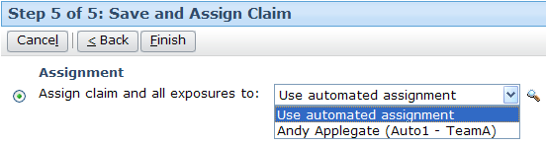
Assigning a new claim: Example
Rules-Based assignment
Explicit assignment
Notes:
Assignment - <number>
The example above shows the assignment of a new claim. This occurs during the second to last step of the full new claim wizard. The user can either search for and select a specific group and/or user (as shown in the "Explicit assignment" screenshot), or the user can specify that automated assignment rules should be used to assign the claim (as shown in the "Rules-Based assignment" screenshot).
If a user specifies only a group, then assignment rules are still used to select a user within that group.

Slide 8
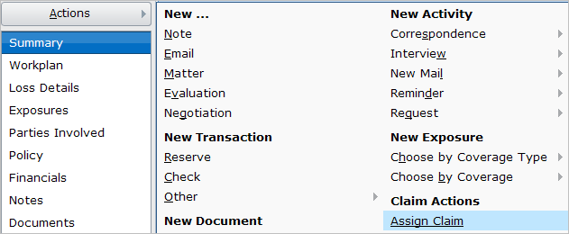
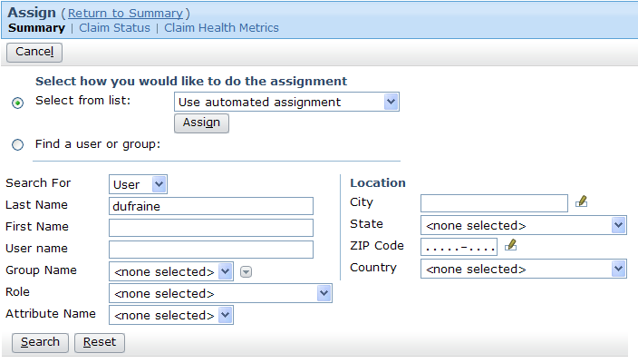
Reassigning an existing claim: Example
Notes:
Assignment - <number>
The example above shows the reassignment of an existing claim. This occurs by selecting the assign claim menu item from the claim's claim Actions menu. The user can either specify that automated assignment rules should be used to reassign the claim, or the user can select a specific group and/or user via the dropdown list or by searching for them.

Slide 9
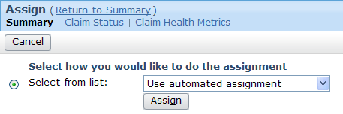
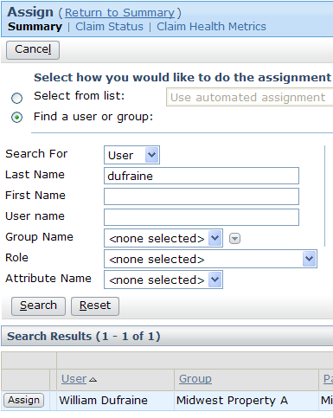
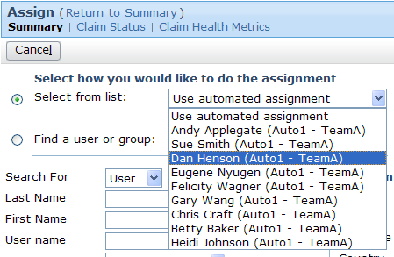
Reassigning an existing claim: Example, cont
Rules-Based
Explicit
Notes:
Assignment - <number>
If a user specifies only a group, then assignment rules are still used to select a user within that group.

Slide 10
Two phases of assignment rules
Peter Beebe
Dana Evans
Western Normal Auto Adjusters
Leroy Martel
Claim 100-00-000027
location: California
seg: mid-complexity
Irvin Hickman
Elias Marr
Western Complex Auto Adjusters
Automated assignment typically involves two phases
  Group assignment
  User assignment (to user within that group)
Notes:
Assignment - <number>

Slide 11
Lesson outline
Assignment basics
Group assignment
User assignment via rules
User assignment via users
Notes:
Assignment - <number>

Slide 12
Groups
Western Auto Adjusters
Western
Regional
Adjusters
Western Fraud Auto Adjusters
A group is a collection of users who share a job function
  The top-level group represents entire organization
  Except for top-level group, every group has exactly one parent
Notes:
Assignment - <number>
Groups are organized into a hierarchy. A group can contain child groups.
Groups are used to help identify which user to assign work to.
The majority of the functionality tied to users and groups exists to facilitate assignment.
The Administration tab displays an expandable tree view of the group structure on the side bar. This is typically visible only to users with supervisor or administrative permissions. An example of the tree view is shown below (which is visible if you view PowerPoint in Notes view (View | Notes Page)). In the example, Elizabeth Lee is the supervisor for the corresponding expanded group.

Slide 13
Users in groups
Peter Beebe
Dana Evans
Western Auto Adjusters
Leroy Martel
"virtual"
group
Leroy Martel
Western
Regional
Adjusters
Irvin Hickman
Western Fraud Auto Adjusters
Irvin Hickman
Elias Marr
Western Complex Auto Adjusters
Notes:
Assignment - <number>
Unlike group-to-group relationships, in which every child group can belong to only a single parent group, user-to-group relationships are many-to-many. A user can belong to multiple groups. (In the example above, both Leroy Martel and Irvin Hickman belong to two groups.) When a user belongs to two or more groups, he or she may get objects assigned to him or her from all of the groups to which they belong. (In the example above, Leroy Martel may get objects assigned to the normal auto group as well as objects assigned to the fraud auto group.)
In a live instance of claimCenter, the majority of the groups reflect the reporting structure of the carrier. (In other words, for most groups, the individuals of the group are all assigned to the same department and all report to the same supervisor.) There are a small number of groups which do not reflect reporting structure, but instead reflect a common job responsibility shared by two or more individuals in different departments. These groups are sometimes referred to as "virtual" groups because they do not represent any aspect of the reporting structure. Virtual groups are created to simplify the assignment of objects which involve similar logic but individuals in different parts of the organization's hierarchy. (In the example above, the "Western Fraud Auto Adjusters" group is a virtual group. It contains two individuals, both of whom belong to other groups. Auto claims which appear to be fraudulent are assigned to this group, regardless of whether they are normal or complex.)

Slide 14

Group attributes related to assignment
Midwest Normal
Auto Adjusters
Southeast Medical
WC Adjusters
Auto
Normal
WC
Medical
Type:
Type:
Regions:
Regions:
Notes:
Assignment - <number>
Groups have the following attributes which may be used in assignment rules:
Type
Region(s)
The group type identifies the kind of work the group is responsible for. The region identifies the location in which the group has responsibilities. Together they are used when an object needs to be assigned to a group of a certain type, but there are multiple groups which do that kind of work. (For example, a carrier may have three regions: North, South, and Central. Each region has four groups, Auto Normal, Auto Complex, WC Medical, and WC Liability. A medical workers' comp claim in Tennessee needs to be assigned to the WC Medical group in the south region. The group type is used to determine which groups in the South region are WC Medical groups.)
Users assigned to a group are assumed to be capable of handling the kind of work the group does, but there is no system functionality to enforce this. In other words, there is no "WC Medical" attribute given to users who are added to a WC Medical group, and there is no WC Medical attribute that a user must have in order to be allowed to be assigned to a WC Medical group. ClaimCenter simply assumes that, unless additional logic states otherwise, every member of a group is qualified to own work assigned to that group.
In addition to type and region, there is a third way in which group-level assignment can be done. An object assigned to a parent group can be assigned using "round robin"ing to one of the child groups. However, this approach to group-level assignment is rarely used. (Round robin assignment is frequently used for user-level assignment.)

Slide 15
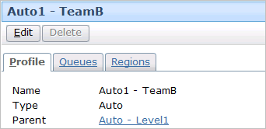
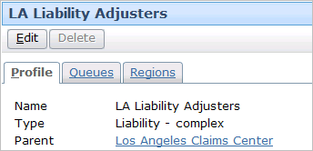
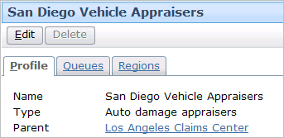
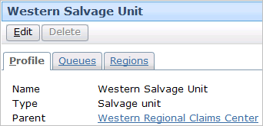
Group type
Group type identifies function of group or job it performs
Notes:
Assignment - <number>

Slide 16
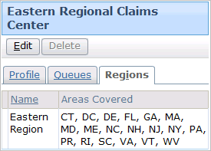
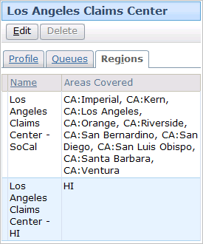
Group region
Eastern States
LA Area & Hawaii
A region is a geographic
region, which can be based
on locale-specific geographic entities such as cities or postal codes
Groups can have one or more regions
Notes:
Assignment - <number>
The type of region to be associated with groups is configured according to the given locale.
In the base application for the USA, regions can be based on states, provinces, counties, cities, or zip codes.

Slide 17
Group assignment using type and region
if loss type = "auto" and segment is "fast track"
then assign to group of type "fast track auto"
where region = loss location region
TYPE
fast track
auto
normal
auto
workers'
comp
fast track auto
west
normal auto
west
workers'
comp
west
west
fast track auto
central
normal auto
central
workers'
comp
central
REGION
central
fast track auto
east
normal auto
east
workers'
comp
east
east
Notes:
Assignment - <number>
The diagram above represents assignment logic that makes use of group type and region.
In this example, the carrier has nine groups. There are three regions (west, central, and east), and three groups in each region. Within a region, there is one group of type "fast track auto" (for auto claims that have been segmented as "fast track"), one group of type "normal auto" (for auto claims that have not been segmented as "fast track"), and one group of type "workers' comp (for workers' comp claims, regardless of how they have been segmented).
The assignment logic states that if a claim is an auto claim and has been segmented as fast track, then it should be assigned to a group with type "fast track auto" and whose region matches where the loss location is. These two criteria uniquely identify a single group for the claim to be assigned to.

Slide 18
Assignment cannot stop at the group level
Peter Beebe
Dana Evans
Midwest Normal Auto Adjusters
Leroy Martel
Claim 100-00-000027
location: Missouri
seg: mid-complexity
Irvin Hickman
Elias Marr
Midwest Complex Auto Adjusters
Objects are not considered assigned until they are assigned to both group and user within that group
Notes:
Assignment - <number>
If an object is assigned to a group without being assigned to a user (or potentially a queue, in the case of an Activity), then ClaimCenter assigns it to a dummy user known as "Default Owner". The object must then be manually reassigned. Ideally, the business logic for assignment should be written such that assignable objects never fail to get assigned to a user.

Slide 19
Lesson outline
Assignment basics
Group assignment
User assignment via rules
User assignment via users
Notes:
Assignment - <number>

Slide 20
Who decides which user within the group gets the object?
Assignment rules
Another user (typically a supervisor)
The owner himself (when he/she takes ownership of an unassigned object)
Peter Beebe
Peter Beebe
Peter Beebe
Notes:
Assignment - <number>
This topic within the lesson focuses on the options for assignment when it is done by the rules engine. The next topic of this lesson focuses on the options for assignment when it is done by a user.
All four types of assignable objects (claims, exposures, activities, matters) can be assigned to a specific user through the rules engine. User assignment through a supervisor typically involves only claims (and not exposures, activities, or matters). User assignment through an unassigned object queue involves only activities.

Slide 21
User attributes related to rule assignment
Peter Beebe
Leroy Martel
Groups
& Load
Factors:
MW Normal
Auto Adjust.
(100)
Groups
& Load
Factors:
MW Normal
Auto Adjust.
(50)
MW Fraud Auto Adjust.
(100)
Español
Attributes:
Attributes: (none)
Regions:
Regions:
Notes:
Assignment - <number>
Users have the following attributes which may be used in assignment rules
Group membership and load factor
Attributes
Region(s)
Recall that a user can be assigned to one or more groups.
Also recall that users assigned to a group are assumed to be capable of handling the kind of work the group does, but there is no system functionality to enforce this. In other words, there is no "WC Medical" attribute given to users who are added to a WC Medical group, and there is no WC Medical attribute that a user must have in order to be allowed to be assigned to a WC Medical group. ClaimCenter simply assumes that, unless additional logic states otherwise, every member of a group is qualified to own work assigned to that group.
Like a group, a user can be associated to one or more geographic regions. An object can be assigned to a user in a particular region. If there are multiple users with the desired attribute(s), the object is round-robined among those users.
User regions are often used to identify a user works within a specific sub-region of the group's region. In the example above, Peter Beebe is a member of the US-MW (midwest) Normal Auto Adjusters group. However, he does not work on claims in the entire midwest region. He works on claims specific to Missouri. All normal auto midwest claims are routed to the US-MW Normal Auto Adjusters group, but Peter Beebe should be considered only when the claim is a normal auto claims specific to Missouri. Setting a region at the user level specifies this.

Slide 22
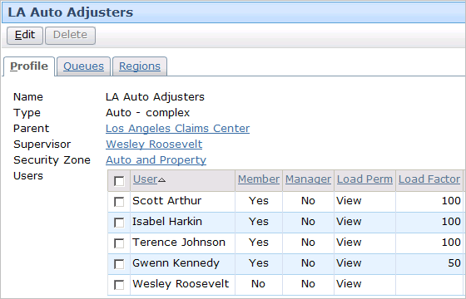
Group assignment and load factors
Objects assigned to a group can be assigned using "round robin"
Load factor weights how often objects are round-robined to that user
Notes:
Assignment - <number>
"Round robin" is a method for assigning an objects to members of a set in a cyclical fashion. When this approach is used, the first member of the set (such as the first user of a given group) is assigned the first object, the second member of the set (such as the second user of a given group) is assigned the second object, and so on. When all of the members have been assigned an object, the cycle repeats with the first member. (For example, if a group had seven users, then the first user is assigned the eighth object, the second user is assigned the ninth object, and so on.) Round robin can be used to distribute objects among users in a given group as well as to distribute objects among child groups in a given parent group.
The primary purpose of load factor is to describe the general amount of work that should be assigned to an individual in a group compared to the other members of the group. In the screenshot above, Gwenn Kennedy would receive half the workload that Scott Arthur, Isabel Harkin, and Terence Johnson receive from the assignment engine (from claims assigned to this group only.) Load factors have no meaning when comparing users across groups.
Load factor is typically a static value assigned by the manager. However, there have been some instances of ClaimCenter in which the rules have been configured to make the load factor values more dynamic.

Slide 23
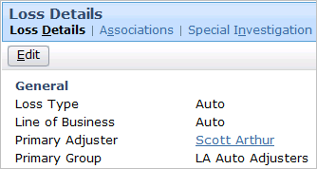
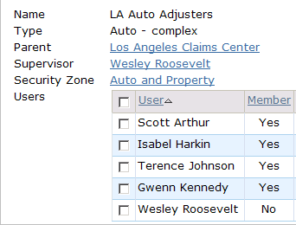
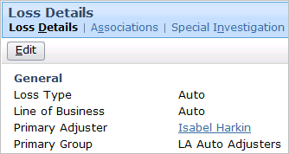
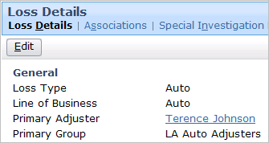
Group assignment with round robin: Example
Claim 1
Claim 2
Claim 3
Notes:
Assignment - <number>
In the example above, three claims are assigned to the LA Auto Adjusters group. Notice that each claim is assigned to the next user in the list. Though the order is not significant, the same criteria are used so that the total assignments are balanced per the load factors.

Slide 24
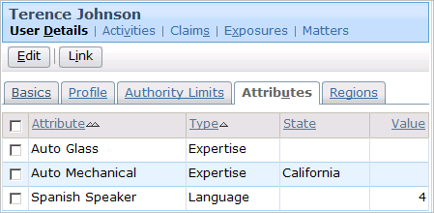
User attributes
Objects can be assigned to a user with a particular attribute (in a particular state and/or of a particular level)
  If there are multiple users with the desired attribute(s), objects are round-robined among those users
Notes:
Assignment - <number>
The attribute can be limited to a single state. The assignment rules can then search for a user with the given attribute in a given state (such as "find a user with auto mechanical expertise in California).
The attribute can have a value, or level of qualification. The assignment rules can then search for a user with the given attribute at the given level (such as "find a user who is a Spanish speaker at level 4 or higher.)
Ideally, whenever there is a user assignment based on attributes, there is more than one user with the required attributes. ClaimCenter automatically uses round robining with user attribute assignment. (For example, if there are 27 users with the "Spanish Speaking" attribute, then the first object goes to the first Spanish Speaking user, the second object goes to the second user, and so on.)

Slide 25
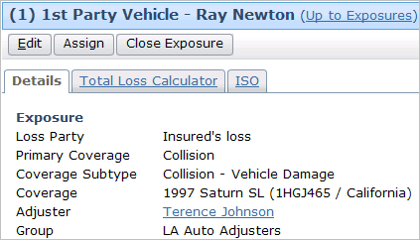
User attribute (with round robin): Example
if insured's language is Spanish
AND
coverage subtype is glass damage
then assign to user with Auto Glass expertise
and Spanish Speaker
Notes:
Assignment - <number>
Recall that ClaimCenter automatically uses round robining with user attribute assignment.

Slide 26
Lesson outline
Assignment basics
Group assignment
User assignment via rules
User assignment via users
Notes:
Assignment - <number>

Slide 27
Who decides which user within the group gets the object?
Assignment rules
Another user (typically a supervisor)
The owner himself (when he/she takes ownership of an unassigned object)
Peter Beebe
Peter Beebe
Peter Beebe
Notes:
Assignment - <number>
There are two assignable objects whose owner is sometimes chosen by a user (as opposed to assignment rules)
Claims are sometimes assigned to a group supervisor, who then selects a user within the group.
Activities are sometimes assigned to a group queue, and users within the queue can take ownership of the activities.
This topic within the lesson focuses on the options for assignment when it is done by a user. The previous topic of this lesson focuses on the options for assignment when it is done by the rules engine.
All four types of assignable objects (claims, exposures, activities, matters) can be assigned to a specific user through the rules engine. user assignment through a supervisor typically involves only claims (and not exposures, activities, or matters). user assignment through an unassigned object queue involves only activities.

Slide 28
"Pending assignment" claims
Terence Johnson
Scott Arthur
Los Angeles
Auto Adjusters
Pending assignments
Wesley Roosevelt
A claim can be set to "pending assignment“ status
  It appears only on a special list visible only to the supervisor of the group
  The supervisor is responsible for manually assigning it to a member of the group
Notes:
Assignment - <number>
The pending assignment of claims is typically used when you want the final assignment of the claim to be based upon human judgment.

Slide 29
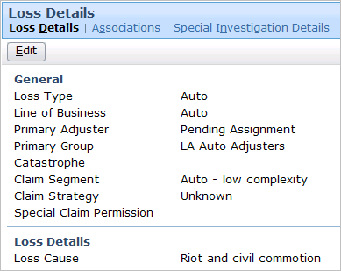
Pending assignment: Example
if loss cause is riot and civil commotion
then set to pending assignment
Notes:
Assignment - <number>
In the example above, all claims with a loss cause of "riot and civil commotion" are assigned to the supervisor of the Los Angeles Auto Adjusters group, who happens to be Wesley Roosevelt. He is then responsible for manually assigning the claim to another user in the group.

Slide 30
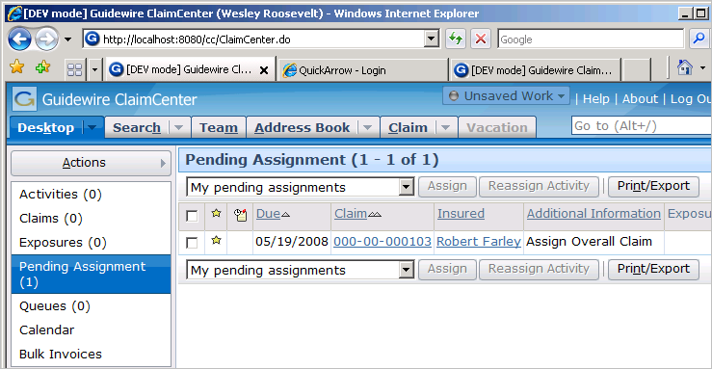
The pending assignment list
Typically, pending assignment is visible only to group supervisors
  Lists claims requiring manual assignment
Notes:
Assignment - <number>
In the example above, the user is Wesley Roosevelt. From his desktop, he can see there is one claim in the pending assignment list. From this list, he can access the claim and/or assign the claim manually as appropriate.

Slide 31
Activity queues
Western
Salvage
Unit
Vehicle salvage opportunity
Lucas Fleming
Vehicle salvage opportunity
Salvage Actions
A queue is a repository associated to a group which contains activities that have been assigned to the group but not yet assigned to any user within that group
  Users within the group can take ownership of activities in the queue
Notes:
Assignment - <number>
Unlike groups and users, which can own any type of assignable object, queues can contain only activities.

Slide 32
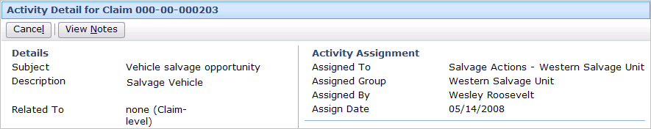
Queue assignment: Example
if activity is a "Vehicle salvage opportunity"
activity
then assign to Salvage queue for group to which
claim is assigned
Notes:
Assignment - <number>
In the example above, all activities which are created from the Vehicle Salvage Opportunity activity pattern are assigned to the Salvage queue for the group to which the claim is assigned. The claim in question is assigned to the Western Salvage Unit group. Therefore, the activity is assigned to the Salvage Actions queue for that group.

Slide 33
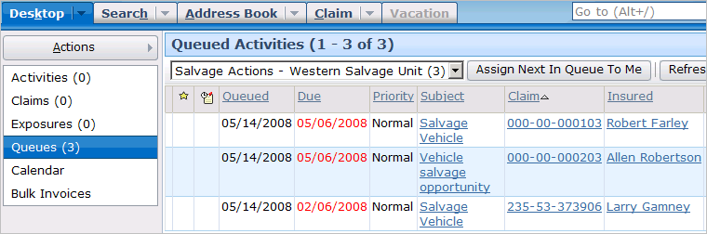
Activities in a queue: Example
From the Desktop, users can
  View activity queues accessible to them
  Take ownership an activity in each queue
    Typically the “next” activity in the queue
    Sometimes user can choose an activity from the queue
Notes:
Assignment - <number>
Users can view objects assigned to queues they have access to by clicking the Queues page link on the Desktop tab. The queues the user has access to are listed in the dropdown at the top of the list. Once the user selects a given queue, all objects in the queue appear in the list. The user can then take ownership of the next activity in the queue by clicking the "Assign Next In Queue To Me" button. Sometimes there will be an “Assign Selected to Me” button if ClaimCenter has been configured to allow it.

Slide 34
Assignment summary
Objects assigned to group first based on:
  Group type, and/or
  Group region
Then, objects assigned to user within group based on:
  Round robining within a group, or
  Round robin among users with given attribute(s), or
  Round robin among users in a given region, or
  Manual assignment of claims by a supervisor via pending assignment list, or
  Manually taking ownership of activities by users via queue
Auto Normal
Español
Notes:
Assignment - <number>

Slide 35
Lesson objectives
You should now be able to:
  Define the assignable objects
  Describe how assignment can be done at the group level
  Describe how assignment can be done at the user level (where the final owner is chosen by rules)
  Describe how assignment can be done at the user level (where the final owner is chosen by a user)
Notes:
Assignment - <number>

Slide 36
Review questions
From a business standpoint, what determines whether a type of object is assignable or not?
When assignment is complete, what is an assignable object assigned to?
When an object is first created, is it assigned by rules or explicitly by the creator?
Identify if the following is a group-level approach to assignment, a user-level approach, or both:
  Type (such as "Workers' Comp")
  Region
  Attribute (such as "Spanish speaker")
  Assignment via activity queue
Notes:
Assignment - <number>
Answers
1. A type of object is assignable if there is some sort of work that needs to be done and a user must be assigned to the object to ensure that it is done.
2. An assignable object is assigned to a user and a group.
3. It depends. The user can choose either approach.
4. a) Group
b) Both
c) User
d) User (activities in an activity queue have been assigned to a group, but not to a user in that group)

Slide 37
Notices
Copyright © 2001-2011 Guidewire Software, Inc. All Rights Reserved.
Guidewire, Guidewire Software, Guidewire claimCenter, Guidewire PolicyCenter, Guidewire BillingCenter, Guidewire Reinsurance Management, Guidewire ContactManager, Guidewire Vendor Data Management, Guidewire Client Data Management, Guidewire InsuranceSuite, Guidewire ContactCenter, Guidewire Studio, Gosu, Deliver Insurance Your Way, and the Guidewire logo are trademarks or registered trademarks of Guidewire Software, Inc. in the United States and/or other countries.
This material is Guidewire proprietary and confidential. The contents of this material, including product architecture details and APIs, are considered confidential and are fully protected by customer licensing confidentiality agreements and signed Non-Disclosure Agreements (NDAs).
This file and the contents herein are the property of Guidewire Software, Inc. Use of this course material is restricted to students officially registered in this specific Guidewire-instructed course, or for other use expressly authorized by Guidewire. Replication or distribution of this course material in electronic, paper, or other format is prohibited without express permission from Guidewire.
    Guidewire products are protected by one or more of the following patents: U.S. Patent No. 7,885,831; U.S. Patent No. 7,788,296.
Notes:
Introduction to Guidewire Configuration - <number>

